Slide 1
Systems of Linear Equations
Session 01-02
Course : MATH6030001 - Linear Algebra
Effective Period : February 2024

Slide 2
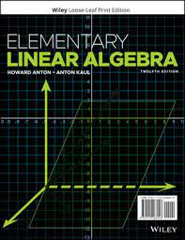
Acknowledgement
These slides have been adapted from:
Howard Anton and Anton Kaul. Elementary linear algebra: Applications version (12th Edition). John Wiley & Sons, 2019.
Section 1.1-1.2

Slide 3

LO 1 : Solve systems of linear equations using various methods.
Learning Objectives
Students will be able to represent real problems in systems of linear equations.
Students will be able to use appropriate methods to solve a system of linear equations.

Slide 4
Contents
1
1
System of linear equations
2
2
Solution
3
3
4
Gaussian and Gauss-Jordan Elimination
4
Homogeneous System
of Linear Equations

Slide 5
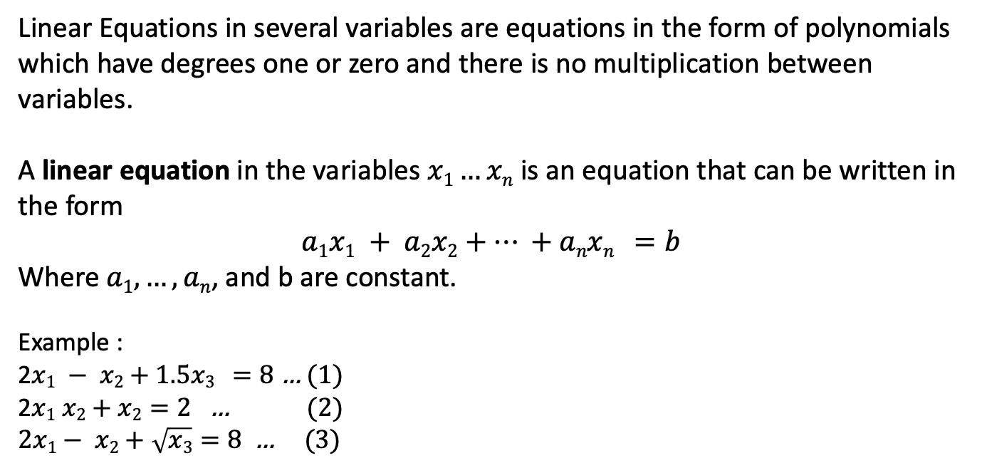
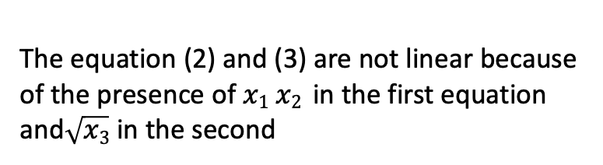
Definition
Linear Equations in several variables are equations in the form of polynomials which have degrees one or zero and there is no multiplication between variables.
A linear equation in the variables $x1…xn$ is an equation that can be written in the form
$$a1x1 + a2x2+… +anxn =b$$
Where$a1, …,an$, and b are constant.
Example :
2$x1 − x2+1.5x3 =8$ … (1)
2$x1 x2+x2=2$ … (2)
$2x1− x2+\sqrt{x3}=8$ … (3)
The equation (2) and (3) are not linear because of the presence of $x1 x2$ in the first equation and$\sqrt{x3}$ in the second

Slide 6
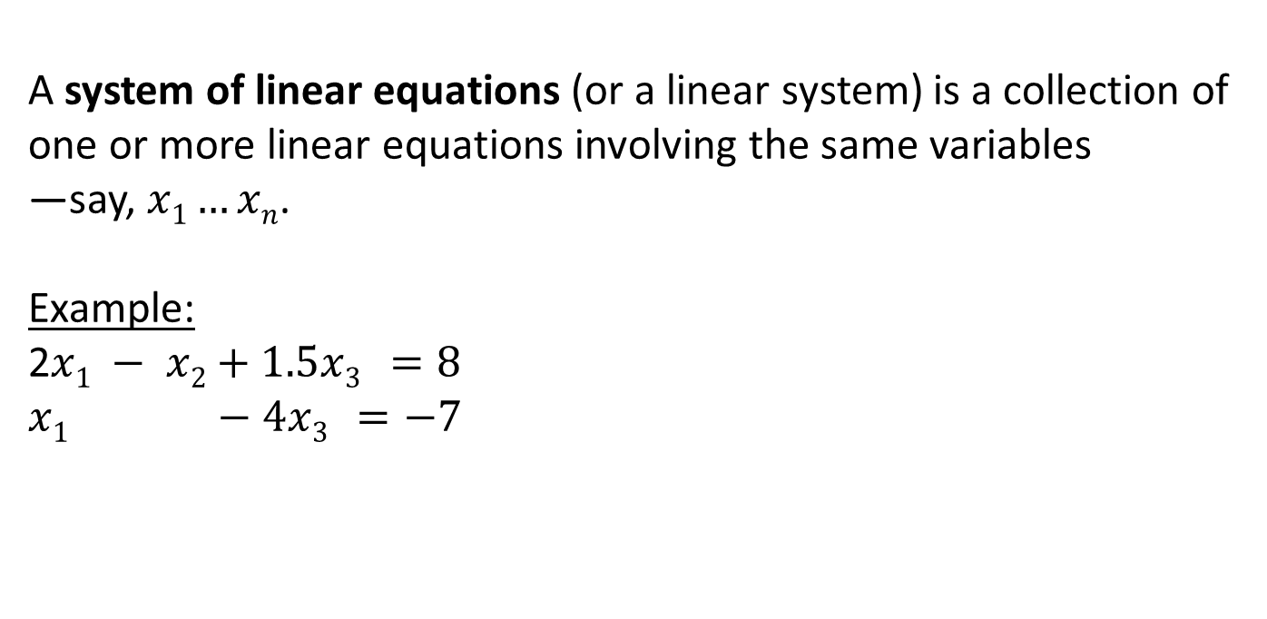
Definition
A system of linear equations (or a linear system) is a collection of one or more linear equations involving the same variables
—say, $x1…xn$.
Example:
2$x1 − x2+1.5x3 =8$
$$x1 −4x3 =−7$$

Slide 7
Solution of linear system

Slide 8
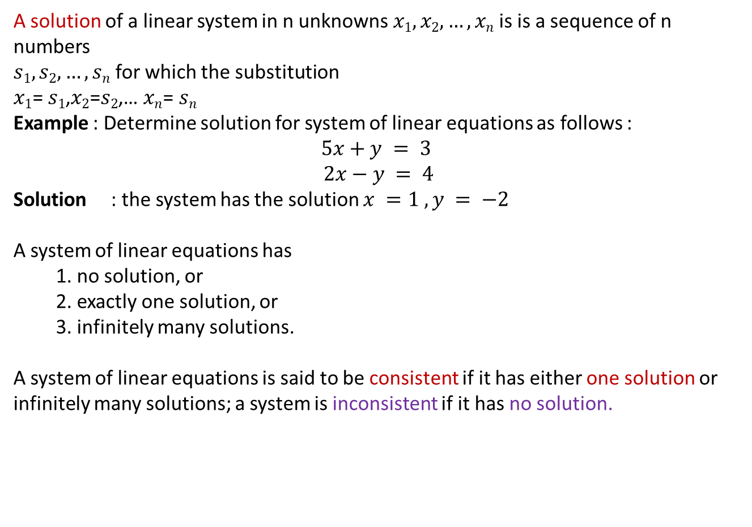
A solution of a linear system in n unknowns$x1,x2,…,xn$ is is a sequence of n numbers
$s1,s2,…,sn$ for which the substitution
$x1$= $s1$,$x2$=$s2$,… $xn$= $sn$
Example : Determine solution for system of linear equations as follows :
$$5x+y = 3$$
$$2x−y = 4$$
Solution : the system has the solution $x =1 , y = −2$
A system of linear equations has
  1. no solution, or
  2. exactly one solution, or
  3. infinitely many solutions.
A system of linear equations is said to be consistent if it has either one solution or
infinitely many solutions; a system is inconsistent if it has no solution.

Slide 9
Linear Systems with Two Unknown
Linear systems in two unknowns arise in connection with intersections of lines. For example, consider the linear system
$$a1x +b1y=c1$$
$$a2x +b2y=c2$$
Each solution (x,y) of this system corresponds to a point of intersection of the lines, so there are three possibilities :
  1. no solution, if the lines may be parallel and distinct,
  2. exactly one solution, if the lines may intersect at only one point.
  3. infinitely many solutions, if the lines may coincide, in which case there are infinitely many points of intersection.

Slide 10
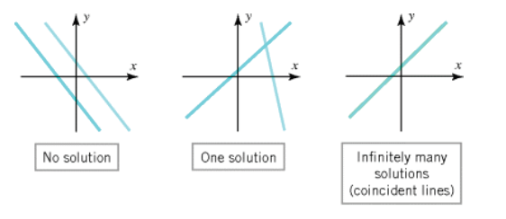
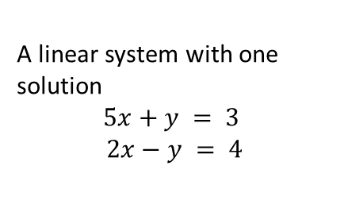
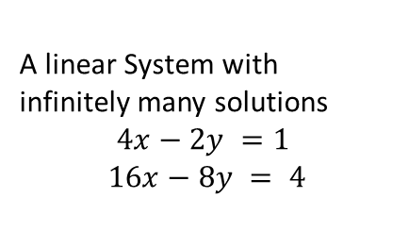
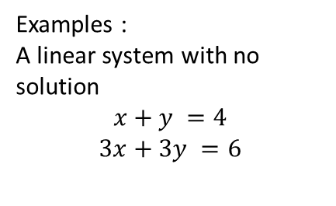
Linear Systems with Two Unknown
Examples :
A linear system with no solution
$$x+y =4$$
$$3x+3y =6$$
A linear system with one solution
$$5x+y = 3$$
$$2x−y = 4$$
A linear System with infinitely many solutions
$$4x−2y =1$$
$$16x−8y = 4$$

Slide 11
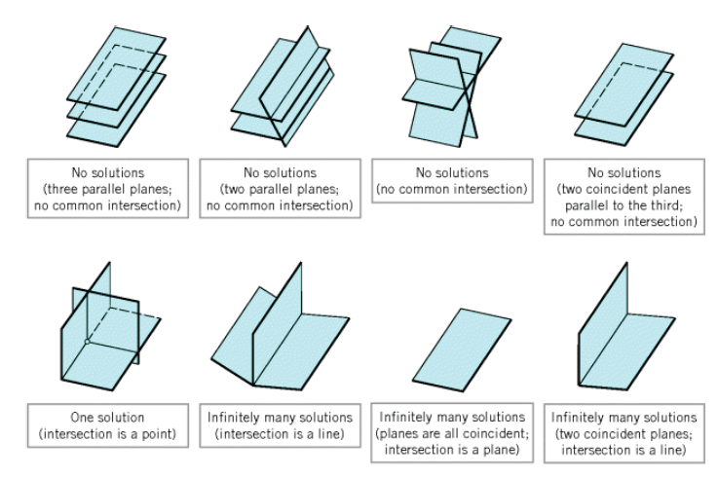

Linear Systems with
Three Unknowns
Similarly, for a linear system of three equations in three unknowns:
in which the graphs of the equations are planes,
the solutions of the system, if any, correspond to points where all three planes intersect.
So again we see that there are only three possibilities: no solutions, one solution, or infinitely many solutions
Ilustration

Slide 12
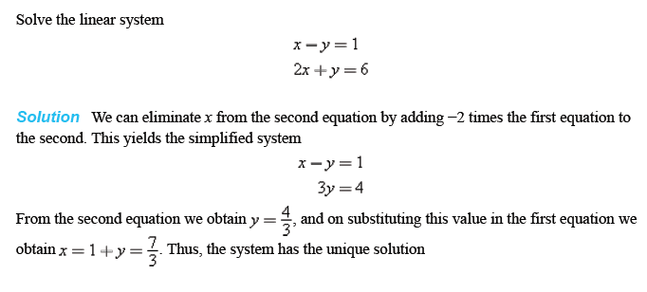
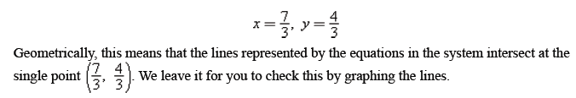
Example: A Linear System with One Solution

Slide 13
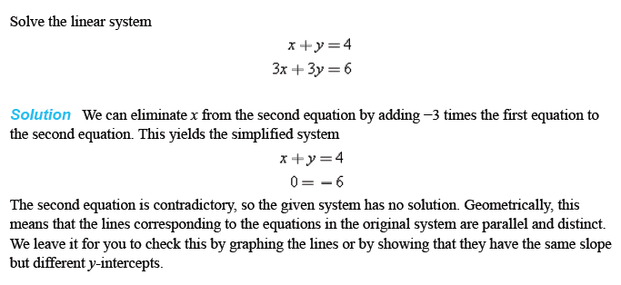
Example: A Linear System with No Solution

Slide 14

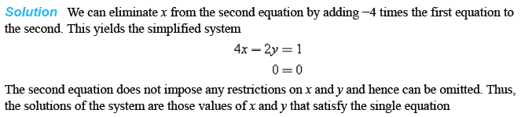
Example 1: A Linear System with
Infinitely Many Solutions

Slide 15
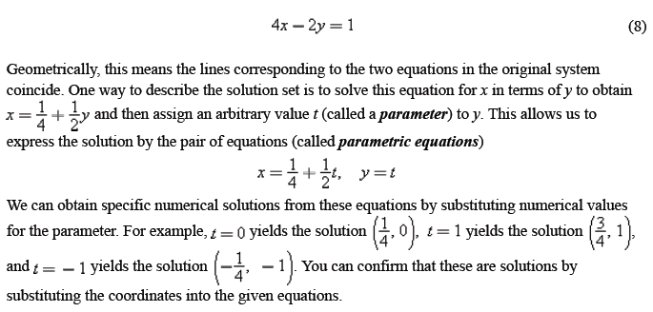
Example 1:
A Linear System with
Infinitely Many Solutions (cont.)

Slide 16
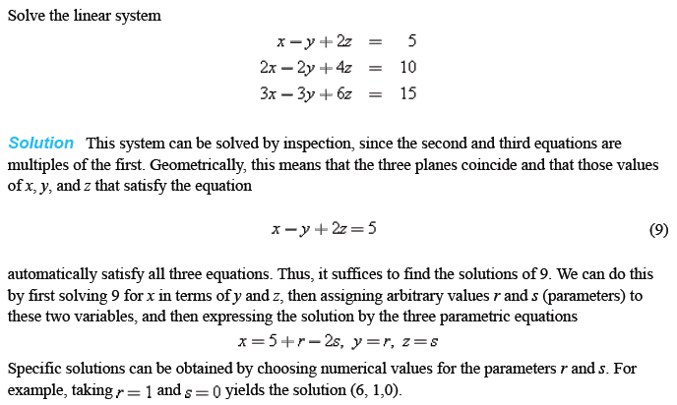
Example 2:
A Linear System with
Infinitely Many Solutions

Slide 17
Gaussian and Gauss-Jordan Elimination
Methods of solving systems of linear equations

Slide 18
A system of linear equation can be represented as a matrix.
This is called the augmented matrix for the system
a₁₁x₁ + a₁₂x₂ + $⋯$+ a_{1n}x_{n} = b₁
a₂₁x₁ + a₂₂x₂ + $⋯$+ a_{2n}x_{n} = b₂
$⋮$ $⋮$
a_{m1}x₁ + a_{m2}x₂ + $⋯$+ a_{mn}x_{n} = b_{m}$.$
$$\left(\begin{matrix}\text{a}\text{11} & \begin{matrix}\text{a}\text{12} & ⋯ & \text{a}\text{1}\text{n}\end{matrix} & \text{b}\text{1} \\ \begin{matrix}\text{a}\text{21} \\ \end{matrix} & \begin{matrix}\text{a}\text{22} & ⋯ & \text{a}\text{2}\text{n} \\ ⋮ & & ⋮\end{matrix} & \begin{matrix}\text{b}\text{2} \\ ⋮\end{matrix} \\ \text{a}\text{m}\text{1} & \begin{matrix}\text{a}\text{m}\text{2} & ⋯ & \text{a}\text{mn}\end{matrix} & \text{b}\text{m}. \end{matrix}\right)$$
Example : Find the augmented matrix of system of linear equation
x₁ + x₂ + 2x₃ = 9
2x₁ - 3x₃ = 1
3x₁ + 6x₂ - 5x₃ = 0
$$\left(\begin{matrix}1 & 1 & \begin{matrix}2 & 9\end{matrix} \\ 2 & 4 & \begin{matrix}−3 & 1\end{matrix} \\ 3 & 6 & \begin{matrix}−5 & 0\end{matrix}\end{matrix}\right)$$

Slide 19
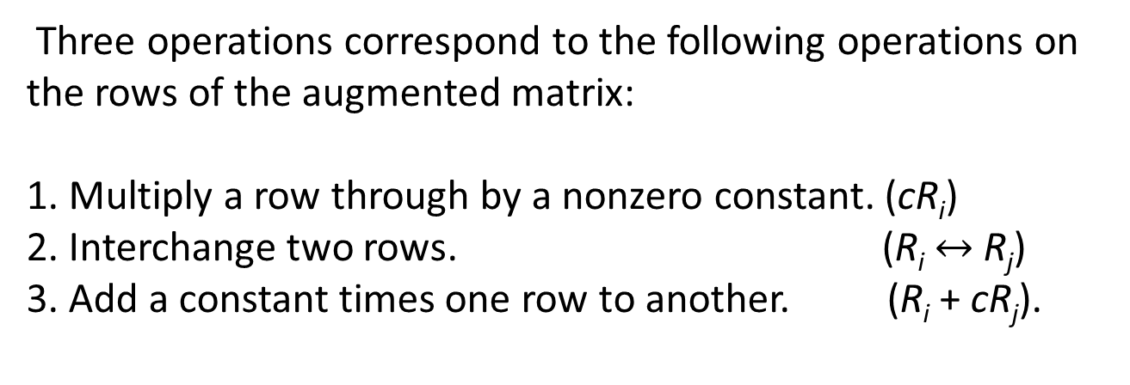
Elementary row operations on a matrix
Three operations correspond to the following operations on the rows of the augmented matrix:
1. Multiply a row through by a nonzero constant. (cR_{i})
2. Interchange two rows. (R_{i} $↔$ R_{j})
3. Add a constant times one row to another. (R_{i} + cR_{j}).

Slide 20
Row echelon form.
A matrix that has the following properties is said to be in reduced row echelon form:
1. If a row does not consist entirely of zeros, then the first nonzero number in the row is a 1.
We call this a leading 1.
2. If there are any rows that consist entirely of zeros, then they are grouped together at the bottom of the matrix.
3. In any two successive rows that do not consist entirely of zeros, the leading 1 in the lower row occurs farther to the
right than the leading 1 in the higher row.
4. Each column that contains a leading 1 has zeros everywhere else in that column.
A matrix that has the first three properties is said to be in row echelon form

Slide 21
Gauss-Jordan elimination.
A matrix that has the following properties is said to be in reduced row echelon form.
1. If a row does not consist entirely of zeros, then the first nonzero number in the row is a 1.
We call this a leading 1.
2. If there are any rows that consist entirely of zeros, then they are grouped together at the bottom of the matrix.
3. In any two successive rows that do not consist entirely of zeros, the leading 1 in the lower row occurs farther to the
right than the leading 1 in the higher row.
4. Each column that contains a leading 1 has zeros everywhere else in that column.
A matrix that has the first three properties is said to be in row echelon form
The procedure (or algorithm) to reduce a matrix into reduced row echelon form
is called Gauss-Jordan elimination.
The procedure (or algorithm) to reduce a matrix into row echelon form
followed by back substitutions is called Gaussian elimination.

Slide 22
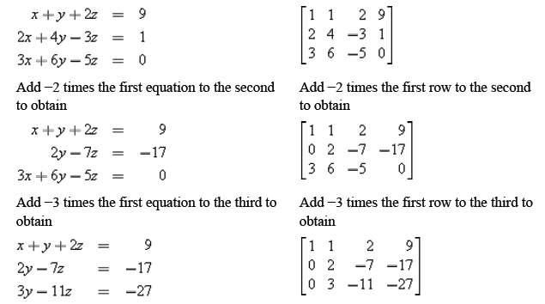
Example 1 : Solve by Gauss elimination.
In the left column we solve a system of linear equations by operating on the equations in the system, and in the right column we solve the same system by operating on the rows of the augmented matrix.

Slide 23
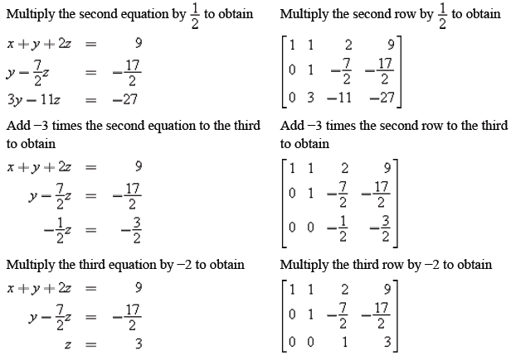
Example 1 : Solve by Gauss elimination. (cont.)

Slide 24
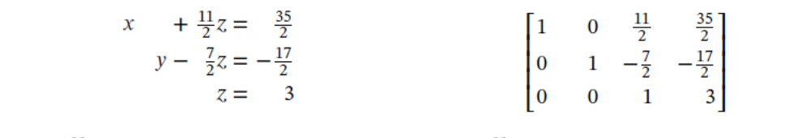
Example 1 : Solve by Gauss elimination (cont.)
We proceed with back substitutions.
From the equations z = 3 and y – 7z/2 = -17/2, we have y = 2.
From the equations z = 3 and x + 11z/2 = 35/2, we have x = 1.
Hence, the solution is x = 1 , y = 2, z = 3.

Slide 25
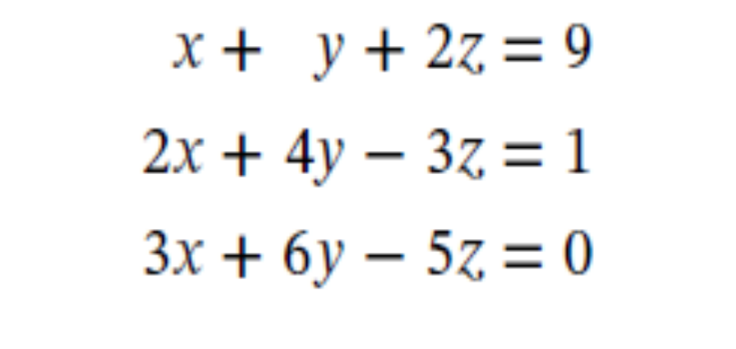
Example 2 : Solve by Gauss-Jordan elimination.
Solve the system of linear equation in the previous example by Gauss-Jordan elimination!

Slide 26
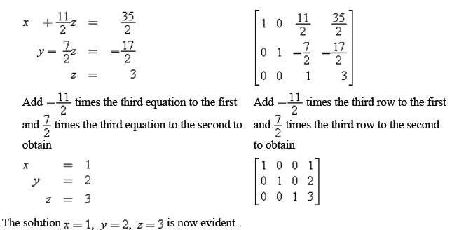
Example 2 : Solve by Gauss-Jordan elimination (cont.)
Solution: Similar as in the previous example, we proceed until we have the augmented matrix in row echelon form.

Slide 27

Homogeneous System of Linear Equations
A system of linear equations is said to be homogeneous if the constant terms are all zero; that is, the system has the form
Every homogeneous system of linear equations is always consistent because all such systems at least have
x₁=0, x₂=0, …, x_{n}=0 as a solution. This solution is called the trivial solution.
If there are other solutions, they are called nontrivial solutions.

Slide 28

Homogeneous System of Linear Equations
Because a homogeneous linear system always has the trivial solution, there are only two possibilities for its solutions:
The system has only the trivial solution.
The system has infinitely many solutions in addition to the trivial solution.
In the special case of a homogeneous linear system of two equations in two unknowns, say
the graphs of the equations are lines through the origin, and the trivial solution corresponds to the point of intersection at the origin.

Slide 29
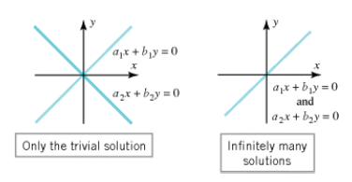
Illustration
There is one case in which a homogeneous system is assured of having nontrivial solutions : whenever the system involves more unknowns than equations.

Slide 30
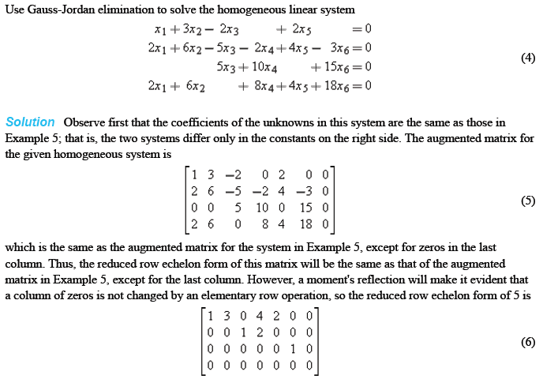
Example : Solving the homogeneous linear system

Slide 31
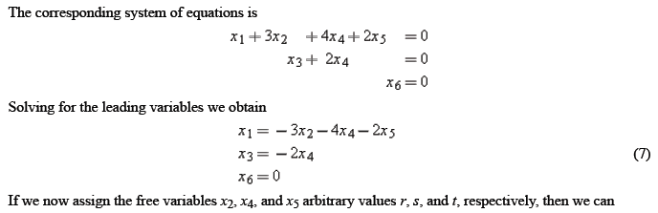

Example (Cont.)

Slide 32
References
    Howard Anton and Anton Kaul. (2019). Elementary Linear Algebra. 12. Wiley. New Jersey. ISBN: 978-1-119-40677-8

Slide 33

Thank You

